Slide 1
A Modality-Aware Spatio-Temporal Fusion Framework
for Brent Crude Oil Forecasting
Financial Time Series + Satellite Imagery + Maritime Networks
XINRUI QI
Supervisor: Beatrice Taylor
Notes:
Hi everyone — I’m Xinrui. And my supervisor is Beatrice Taylor.
My project is about forecasting next-week Brent oil prices, using three kinds of data:
financial markets, satellite imagery, and shipping networks.
The main question is:
not only what data to add, but how to use them well.

Slide 2
Research Context & Motivation
STEP 1
Does this extra data actually help at all?
Background: Oil prices affect inflation, energy costs, and trade — so better short-term forecasts matter for markets and policy.
Motivation: Beyond finance and macro signals, satellite images of oil ports and shipping data on chokepoints and traffic might hint at supply-and-demand shifts before price reacts.
Target: Next-week Brent Price (weekly).
Strong Baseline: Same as last week
STEP 2
If yes — is it enough to just add it as extra columns into the model?
STEP 3
If not — does it help to let each type of data learn on its own first, then combine them?
Q1
On top of finance data alone, do satellite and shipping data add real predictive value?
Q2
Does learning each data type separately, then combining them, work better than just adding everything as columns?
Q3
Which data type matters more?
1
Notes:
Lets start with why this matters.
Oil prices affect many things we pay for every day. When oil prices rise, energy bills and inflation often rise as well. So being able to predict oil prices one week ahead could be useful, not just academically, but in the real world.
The problem is that oil prices are very hard to predict.
A very simple rule — assuming next week will look like this week — already works well, or best in the literature. So any more complex model needs to beat a strong baseline.
That is why I look beyond the usual economic data.
Oil is a physical commodity /kəˈmɒdəti/. We can use satellite images to observe activity around ports and terminals. We can also track tankers moving through important shipping routes. These signals may change before the oil price changes.
My study asks three simple questions.
First, do these new data sources improve the forecast?
Second, is it enough to put all the data into one model?
Third, can we do better by learning from each data source separately and then combining them?

Slide 3
Research Structure
M0 No-Change Forecast
FLAT LAYER (feature concatenation)
M2
Finance + RS
M1
Finance
M4
Finance + RS + Shipping
M3
Finance + Shipping
FUSION LAYER (modality-specific encoders)
M2_Deep
Finance+ RS
M1_Deep Finance
M4_Deep
Finance + RS + Shipping
M3_Deep
Finance +Shipping
Extra models built for comparison： single-modality models (M_Deep_Ship, M_Deep_RemoteSense), different concatenation models (M_concat)
2
Notes:
This slide shows the overall structure of the thesis.
At the top, I have a very simple baseline: next week’s price is same as this week’s. Every model has to be compared with this baseline.
Then I test the same idea in two different ways.
The first is the flat layer.
I start with financial data only, as Model 1. Then I add satellite data as Model 2, shipping data as Model 3, or both as Model 4. M2 and M3 are two separate branches.
In this layer, all the variables are simply added as extra columns /ˈkɒləmz/ in one large table. This helps me see which type of data is actually useful.
The second is the fusion layer.
The data combinations are the same, but the structure is different. Each data type has its own specialized model.
I use TCN, temporal convolutional network, to learn patterns over time in the financial data.
For shipping, I use GAT, graph attention network, to learn the connections between ports and chokepoints.
For satellite data, I use Prithvi /ˈprɪθvi/, a specialized encoder that turns satellite images into useful numerical features.
The outputs are then combined using gated fusion. This means the model can learn, week by week, how much to trust each type of data.
I also keep a simple vector-concatenation /kənˌkætəˈneɪʃən/ model as a control. This allows me to test whether the smarter fusion method really adds value.
So the flat layer asks: is there useful information in these new data sources, and can a large table use it?
The fusion layer asks: can a better model structure make better use of that information?
Next, I will show the results from the flat layer.

Slide 4
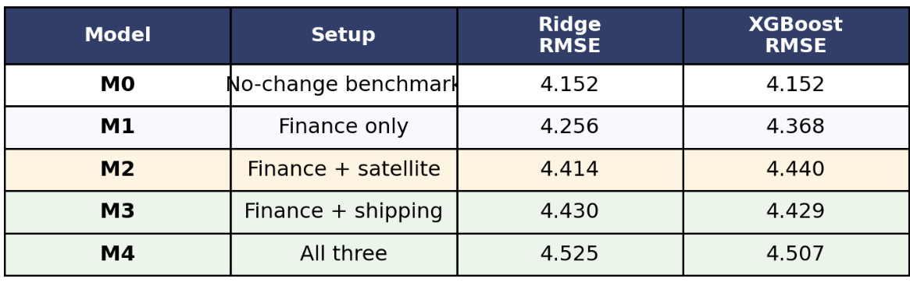
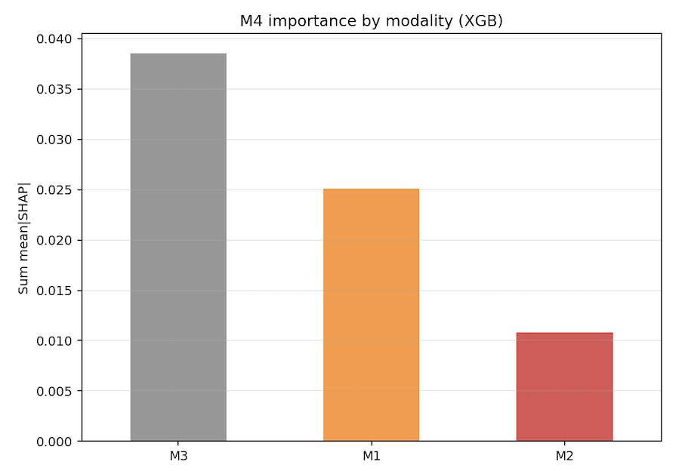
Flat layer: What Each Data Type Contributes
Model: Ridge + XGBoost on one big table (M0–M4), chosen from the literature's usual benchmarks.
No-Change forecast remains hard to beat.
Shipping helps: adding shipping on top of finance gives a clear nested gain under XGBoost; Ridge often can't use it.
Satellite is weak: adding satellite alone isn't clearly helpful in the main full-column setup.
What the model leans on (SHAP, M4): shipping 52% > finance 34% > satellite 15%
In the big table, shipping looks useful — about 3x satellite's share, ~37 points higher — and satellite looks weak. But even useful shipping is hard to turn into clean gains once everything is flattened together.
3
Notes:
I use two common benchmark models from the oil forecasting literature.
One is a regularized linear model. The other is a tree-based model.
Both models use the same features and the same walk-forward testing process.
The main result is not that these models easily beat the naive forecast. That is still very difficult.
The more useful result is that the type of data matters.
Shipping data gives the clearest signal.
When I add shipping data to the financial data, the tree model improves clearly compared with the finance-only model. The linear model often does not.
This suggests that the useful information is there, but the relationship is not simple or linear.
Satellite data gives a different result.
When I add satellite data on its own, I do not see a clear improvement in the main flat setup.
The SHAP chart tells the same story.
In the full flat model, shipping data is the most important, followed by financial data. Satellite data contributes the least.
The contribution from shipping is about three times larger than the contribution from satellite data.
So the main lesson from the flat layer is this:
Alternative data do contain useful information, especially shipping data. But simply putting everything into one large table does not use that information very well.
That is why I move to specialized models in the next stage.

Slide 5
Fusion layer: Current Findings
Combo
Flat Model
Fusion Model
Notes
Finance + shipping
≈ −6.7%
≈ +0.11%
Fusion model improves a lot, close to no-change baseline.
Same inputs, better use:
smart weighting beats simply gluing learned vectors.
Finance + satellite
≈ −7.0%
≈ −2.4%
Fusion model improves a bit, but satellite is still weak.
All three
≈ −8.6%
≈ −1.3%
Fusion better than flat.
% change vs No-Change (higher = better)
Just adding data as columns wastes most of what shipping and satellite data offer; learning each on its own recovers a lot of it — shipping much more so than satellite, so far.
4
Notes:
The data combinations are the same as before. But now, each type of data has its own model. I then combine the outputs using smart weighting.
Let’s look at the table row by row.
Finance plus shipping shows the biggest change.
In the flat setup, it was still below the no-change baseline. With fusion, it is the only combination that moves slightly above it.
So this is where the new architecture helps the most.
Finance plus satellite also improves, but it is still below the baseline.
This means the better structure helps a little, but satellite data is still the weakest source.
The model using all three data types sits somewhere in between.
It performs much better than the full flat model, but it is still not as strong as finance plus shipping.
So adding satellite data does not automatically make the full model better.
There is also an important design point.
It is not enough to train each data type separately and then simply join the vectors together. The way the model combines and weights them matters.
The smart weighting method performs better than simple concatenation.
So the main message from the fusion layer is this:
The flat models showed that useful signals exist. The fusion models show that we can use more of those signals, especially from shipping data, but we have to stop treating every variable in the same way.

Slide 6
Thank You For Listening
XINRUI QI xinruiqi7@gmail.com

